Slide 1
Clinical Assessment of Pregnant Women: 2. Abdominal Examination
Hamdy Bakry Alqenawy, MD
Lecturer in Obstetrics & Gynecology
Ain Shams University Faculty of Medicine Galala University Faculty of Medicine

Slide 2
Approach to your patient’s condition
Patients “present” with a complaint/presentation, NOT the diagnosis.
Assessment is through: ❶History, ❷Examination and ❸Investigations. It should happen this way, not the other way round.
It’s OK to start with a differential and narrow it down. This is the norm in Medicine.
History → Differential diagnosis
Examination → Provisional diagnosis
Investigations → Definitive diagnosis (usually!)

Slide 3
Assessment: Maternal & Fetal
History
Examination
General: as usual + systems other than that of interest
Abdominal: as usual + gravid uterus
Inspection
Palpation
Fundal height
4 maneuvers of Leopold
Uterine contractions
? Percussion
Auscultation
Local = vaginal
Digital, bimanual
Speculum
Investigations
Labs
Imaging

Slide 4
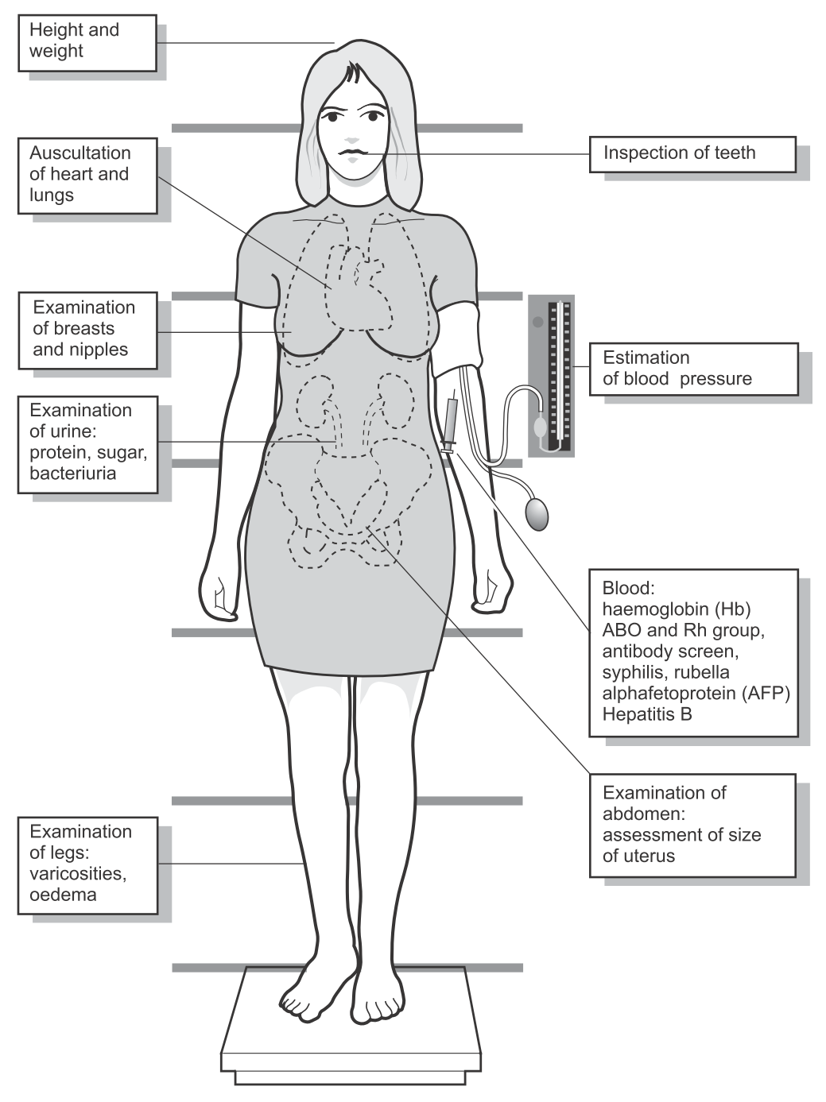
General Examination

Slide 5

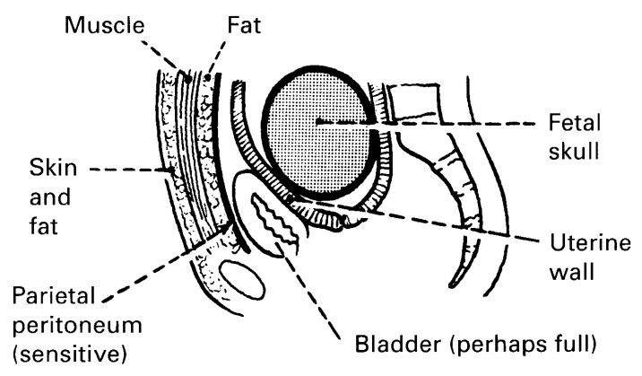
Abdominal Examination
Must be done systematically.
These tissue layers may interpose between your hand and the fetal head:
https://www.youtube.com/watch?v=-pkkgBX7OFQ

Slide 6
Getting Ready
Introduce yourself: name and role
Check the patient’s name (and DOB)
Explain what you are going to do and why, and ask if this is OK (consent)
Ask her to pass urine if needs to
Position: supine with the head of the bed raised 15°
You
The patient
The environment
Chaperone
Prepare tools: measuring tape, Pinard stethoscope or Doppler transducer, gel
Prepare: wash and warm your hands
Exposure: from the xiphisternum to the pubic symphysis
Privacy

Slide 7
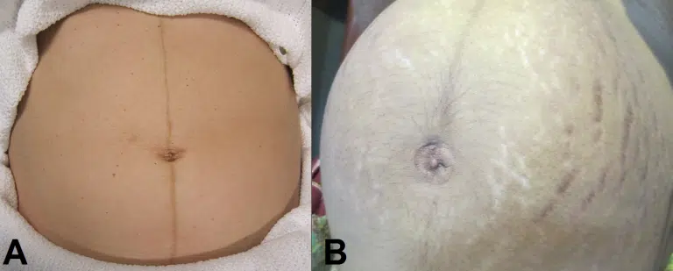
Inspection
Size and contour (distension compatible with pregnancy),
scars of previous operations,
hernias (umbilical, inguinal or femoral),
divarication of the recti muscles,
skin pigmentation (linea nigra),
stretch marks (striae gravidarum / albicans),
fetal movements (>24 weeks),
grooves (above or below the umbilicus).

Slide 8
Palpation
Palpate the whole abdomen with the palmar surface of the hand for:
masses,
tenderness,
guarding or rigidity
while keeping eye contact with your patient.
Palpate for the liver, spleen and kidneys. (? The back?)
Feel the uterus for
uterine contractions
irregularities:
leiomyomas or
congenital abnormality such as bicornuate uterus.
The fetus…

Slide 9
Palpation (the fetus)
Regular abdominal palpation is the easiest and cheapest method of fetal monitoring.
Repeated examinations by the same observer may give a first indication of
growth restriction, or
excessive increase in uterine size due to polyhydramnios.
Palpate for | Fetal size | & | Fetal orientation
 | Fundal level SFH |  | The 4 maneuvers of Leopold…

Slide 10
Abdominal palpation
We try to answer these questions:
Is the size consistent with estimated GA?
Is the lie longitudinal?
Where is the back of the fetus?
What is the presentation?
Is the head engaged?

Slide 11
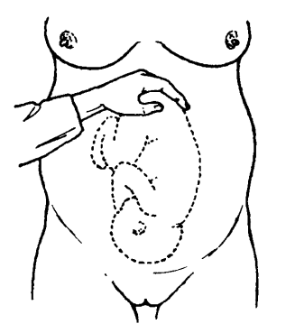
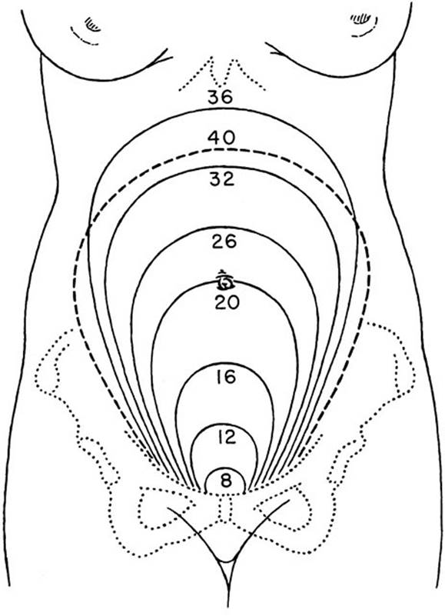
① Is the size consistent with estimated gestational age?
1. Using anatomical landmarks
Landmark | Corresponding GA
Xiphisternum | ~ 36 wk
midway | ~ 28 wk
Umbilicus | ~ 20-22 wk
midway | ~ 16 wk
Symphysis | ~ 12 wk

Slide 12
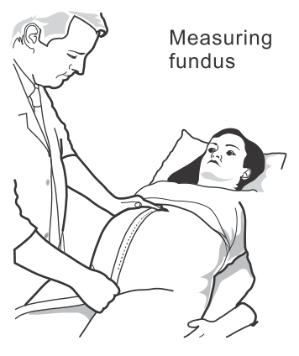


① Is the size consistent with estimated gestational age?
2. Measuring symphysis-fundal height
After 20 weeks, the height of the fundus in centimeters should equal approximately the weeks of gestation.
Technique: Symphysis → Fundus

Slide 13
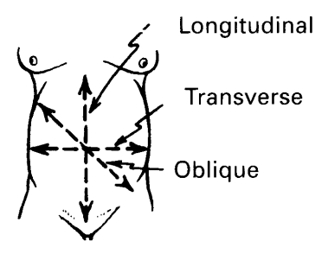
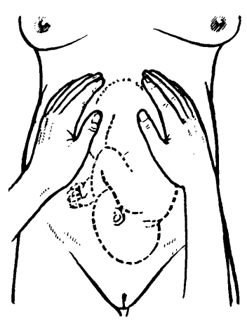
② Is the lie longitudinal?
Lie = relation of the long axis of the fetus to the mother.
Only a longitudinal lie is normal.
The fundal grip
The fundus is palpated and its contents (here the buttocks) identiﬁed.

Slide 14
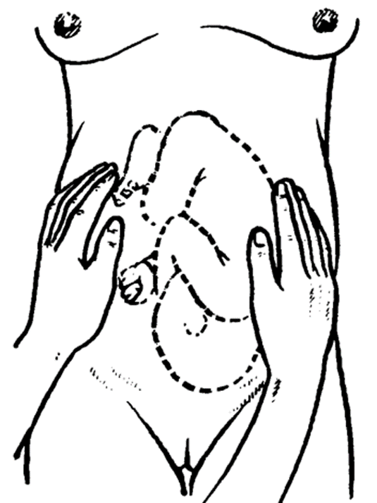
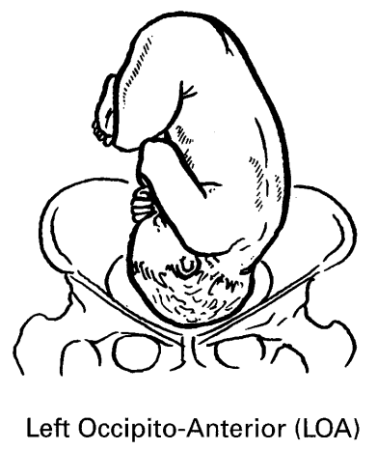
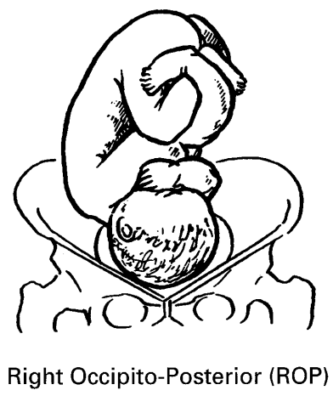
③ Where is the back of the fetus?
The lateral (umbilical) grip
Back anterior and to the left (most common)
Back posterior and to the right
Anterior positions are regarded as normal as the occiput will rotate forward in labor.
In posterior positions, labor may be longer and more difficult.
Palpate the contours of the uterus, identifying the back and the limbs.

Slide 15
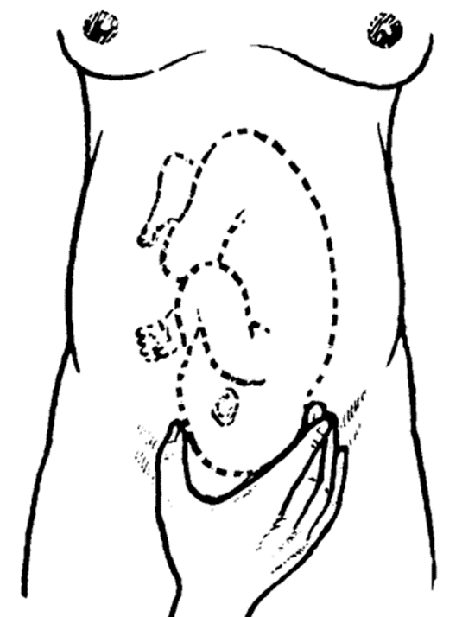
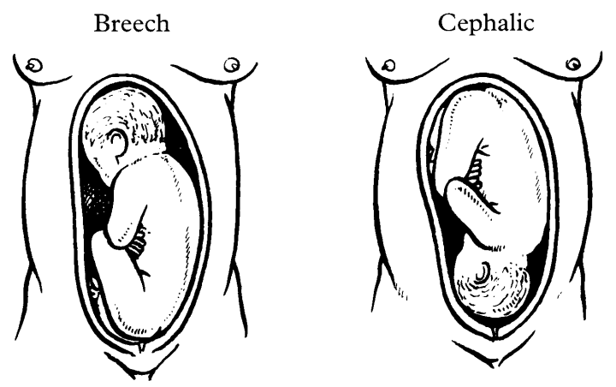
④ What is the fetal presentation?
Presentation = lowermost part of the fetus entering the maternal pelvis first.
Cephalic, Vertex, Breech
Only a cephalic presentation is normal after 32 weeks.
At 30 weeks, however, up to 25% of babies present by the breech.
The first pelvic grip
Palpate the head, and note whether it is mobile or fixed in the brim.

Slide 16
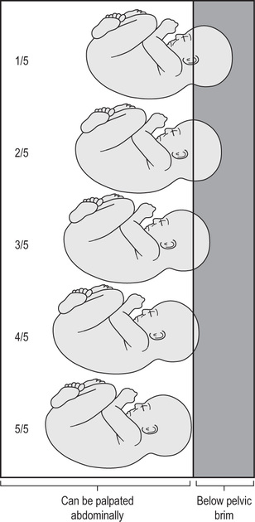
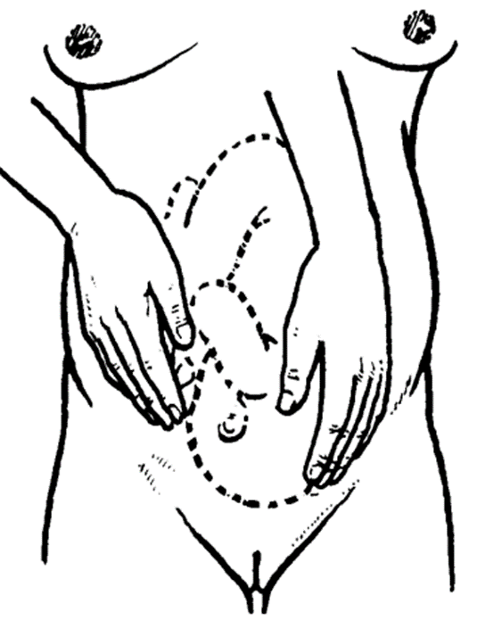
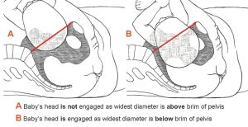
⑤ Is the head engaged?
Engagement = the descent of the widest dimensions of the presenting part through the pelvic brim.
Identify the number of ‘fifths’ palpable abdominally.
When the head is engaged, 2/5 or less will be felt.
The second pelvic grip
Face the patient’s feet and push 2 fingers towards the pelvis to determine whether it is fixed or mobile.

Slide 17
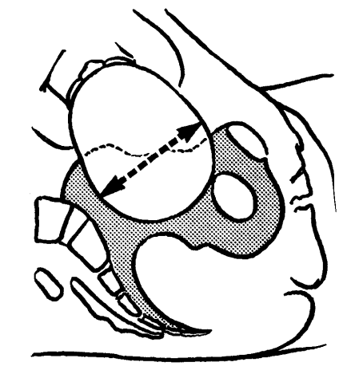
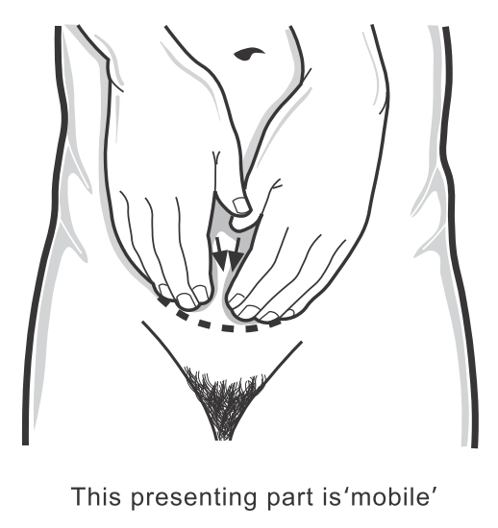
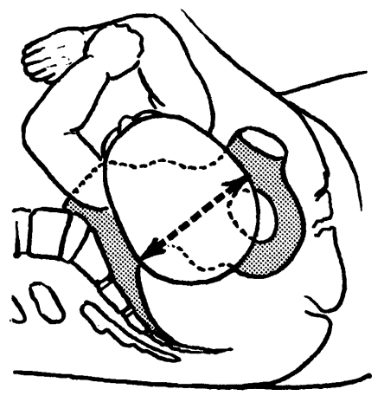
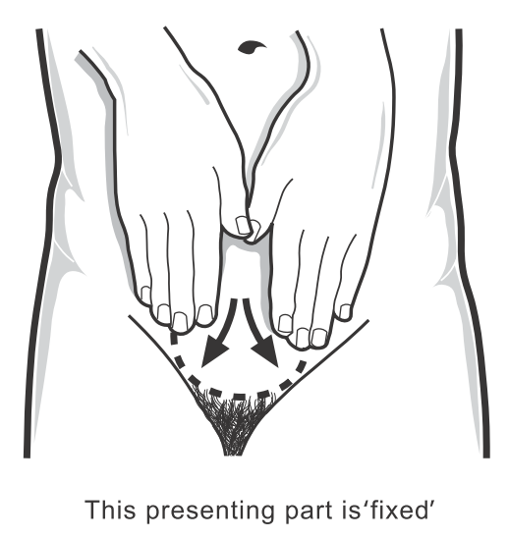


⑤ Is the head engaged?
Non-engaged
Engaged
The head is ≥ 3/5 palpable
The presenting part is “mobile”
The head is ≤ 2/5 palpable
The presenting part is “fixed”

Slide 18
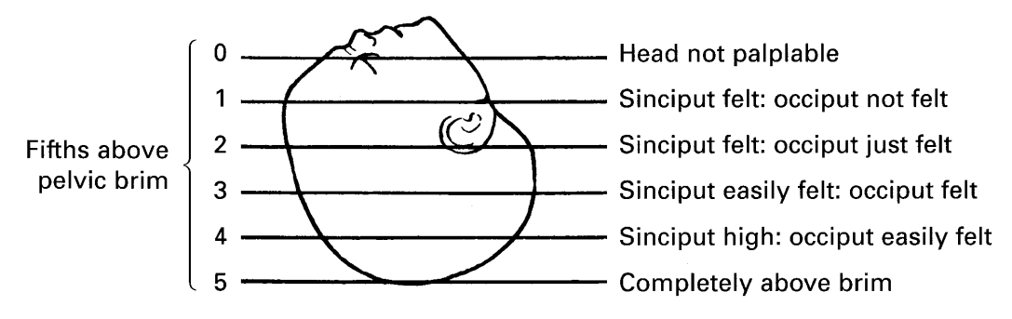
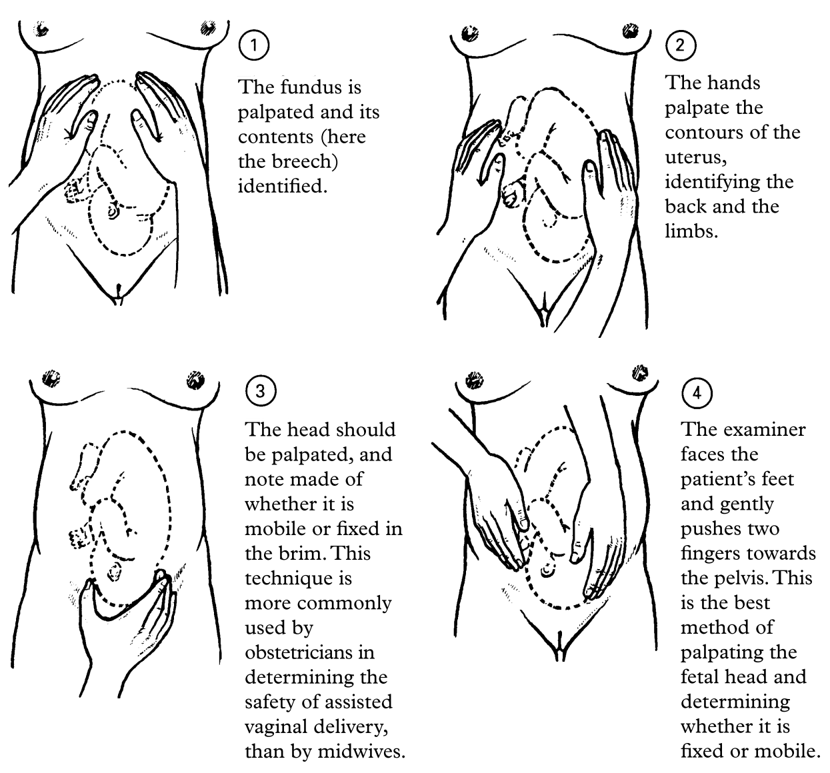
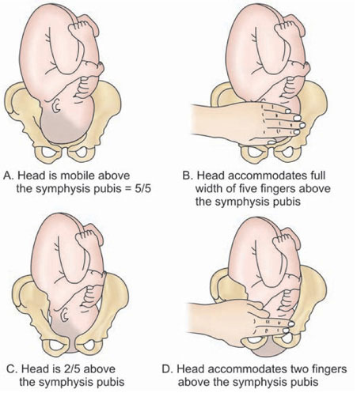
The 4 maneuvers of Leopold
Methods of estimating fifths
OR

Slide 19
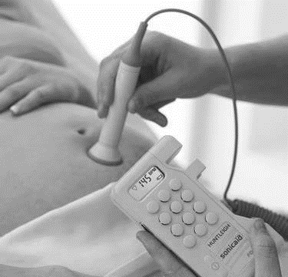
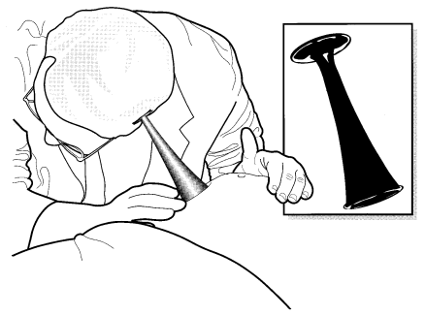
Auscultation
Listen over the fetal back (lie and position should have been established):
Cephalic → in the lower quadrant
Breech → at level of umbilicus
Using
hand-held Doppler
Pinard’s stethoscope
One minute
Hands off
Maternal pulse

Slide 20
At the End
Report the findings to the patient
Record the findings in the patient’s documents
Tell her the next appointment, and investigations if required
Give her the warning signs to visit before the next appointment

Slide 21
Tips
Ask the woman to lie on her back on the examination table with a pillow under her knees to relax her abdominal muscles.
Stand on the right side of the patient. (??)

Slide 22
Thank You
Open Discussion

